Slide 1


Analog Electronic Circuits
(UEC301)
By
Dr.Mayank Kumar Rai
Associate Professor
ECED,TIET

Slide 2

Subject: Analog Electronic Circuits (UEC301)
Lecture topic : Load Line analysis

Slide 3
Key points
Load Line
Three different points
Cut-off point
Saturation point
Operating point
Three different Regions
Saturation Region
Active Region
Cut-off Region
Contents of this lecture are based on the following books:
Jacob Milman & and C.C.Halkias, “Integrated Electronics Analog and Digital Circuit and Systems”Second Edition.
Adel S. Sedra & K. C. Smith, “MicroElectronic Circuits Theory and Application” Fifth Edition.
Robert L. Boylestad & L. Nashelsky, “Electronic Devices and Circuit Theory” Eleventh Edition.

Slide 4
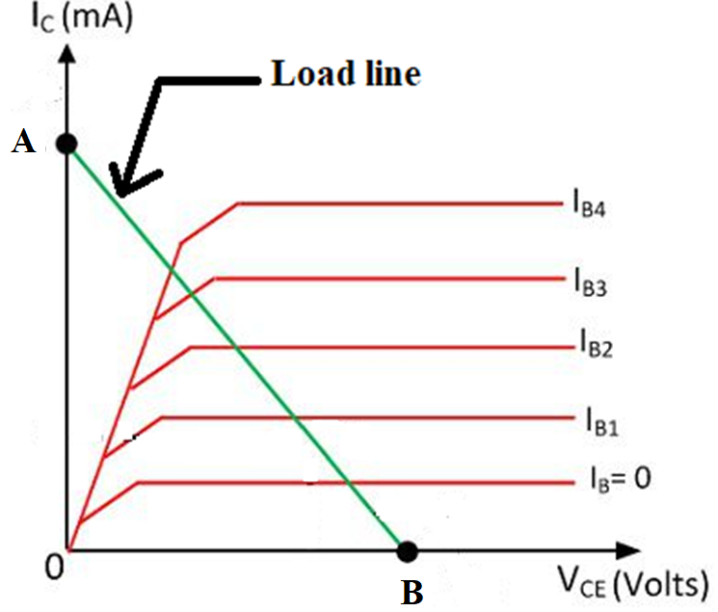
Load Line

Slide 5
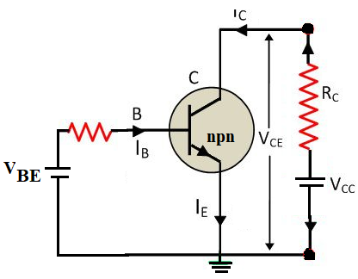
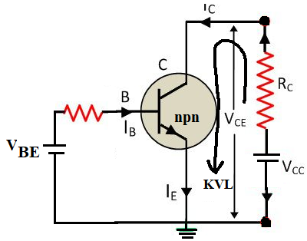
Cont..

Slide 6
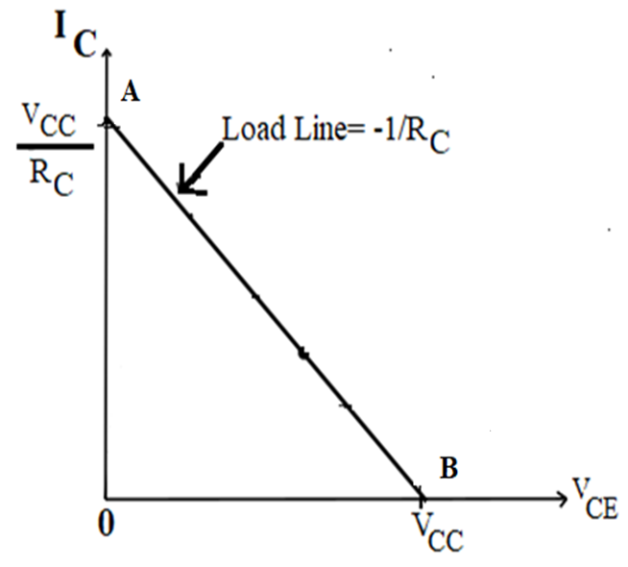
Cont..
V_{CC} = V_{CE} + I_{C}R_{C} (1)
The end point of the line are located as
V_{CE} is maximum when I_{C} = 0 then from the equation (1)
V_{CE} = V_{CC}
I_{C} becomes maximum when V_{CE} = 0 then from the equation (1)
I_{C}=V_{CC}/R_{C}

Slide 7
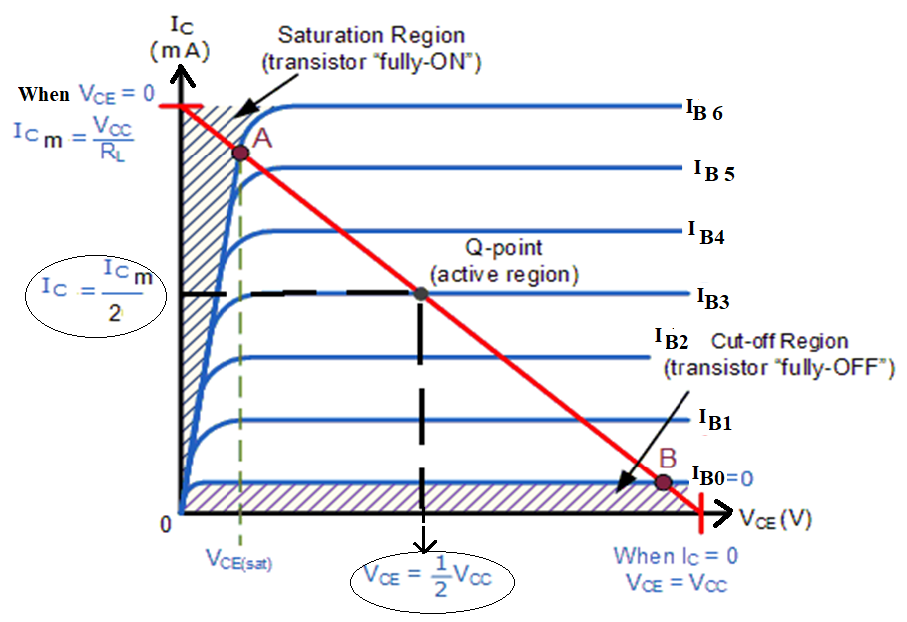
Different points and Regions
Saturation
Active
Cut-off

Slide 8
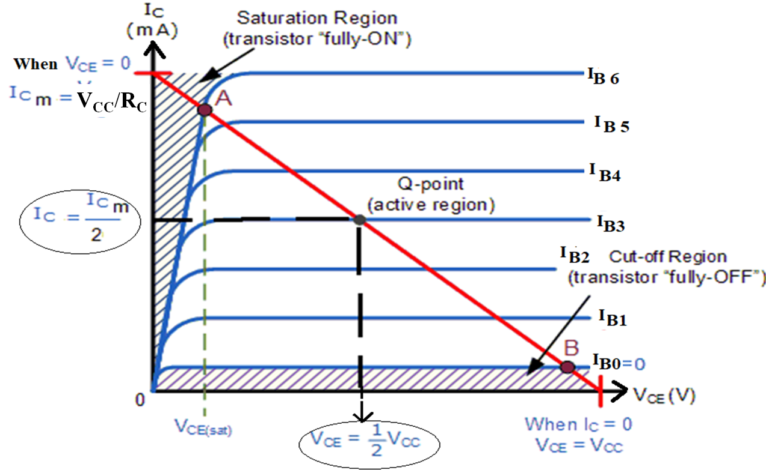
Saturation, Active and Cut-off Regions

Slide 9
Thank You

